Slide 1
Chap#15
Network Security

Slide 2
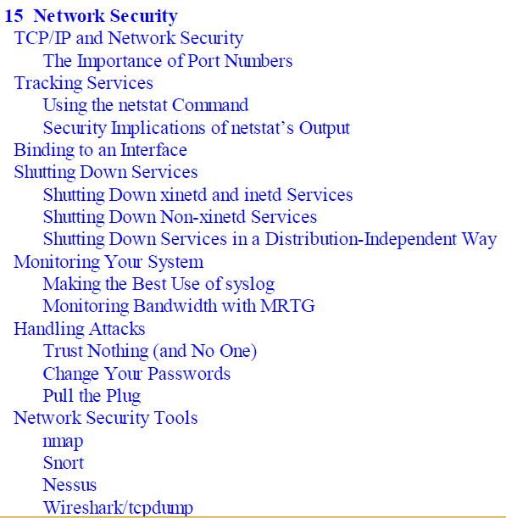

Slide 3
Introduction
In Chapter 14, you learned that exploit vectors are of two types: those in which the vulnerability(open to attack) is exploitable locally and those in which the vulnerability is exploitable over a network. The former case was covered in Chapter 14.
The latter case is covered in this chapter Network security addresses the problem of attackers sending malicious network traffic to your system with the intent of either making your system unavailable (denial-of-service, or DoS, attack) or exploiting weaknesses in your system to gain access or control of the system.
Network security is not a substitute for the good local security practices discussed in the previous chapter. Both local and network security approaches are necessary to keep things working the way that you expect them to work.
This chapter covers four aspects of network security: tracking services, monitoring network services, handling attacks, and tools for testing.

Slide 4
TCP/IP and Network Security
The following discussion assumes you have experience configuring a system for use on a TCP/IP network. Because the focus here is on network security and not an introduction to networking, this section discusses only those parts of TCP/IP affecting your system’s security. If you’re curious about TCP/IP’s internal workings.
The Importance of Port Numbers
Every host on an IP-based network has at least one IP address.
TCP/IP adds a component identifying a TCP (or User Datagram Protocol [UDP]) port. Every connection from one host to another has a source port and a destination port. Each port is labeled with an integer between 0 and 65535.
To identify every unique connection possible between two hosts, the operating system keeps track of four pieces of information: the source IP address, the destination IP address, the source port number(source operating system), and the destination port number(host-to-host connections).
port 80 is the well-known service port for HTTP.

Slide 5
Tracking Services
The services provided by a server are what make it a server. The ability to provide the service is accomplished by processes that bind to network ports and listen to the requests coming in.
This section discusses the usage of the netstat command, a tool for tracking network connections in your system. It is, without a doubt, one of the most useful debugging tools in your arsenal for troubleshooting security and day-to-day network problems.
Using the netstat Command
To track what ports are open and what ports have processes listening to them, we use the netstat command. That means we’ll see not only the connections that are actually working over the network, but also the interprocess communications.
netstat to show us all ports (-a)—whether they are listening or actually connected—for TCP (-t) and UD(-u).
Security Implications of netstat’s Output
To see which process is associated with a port, use the –p option with netstat.
rule of thumb is that the side whose port number is greater than 1024 is the side that originated the connection.
Notes:
Implication: Importance

Slide 6
Binding to an Interface
A common approach to improving the security of a service running on your server is to make it such that it binds only to a specific network interface.
you arrange that connections will have to originate from the server itself to communicate with the service.
Notes:
eth0, with the IP address: 192.168.1.4

Slide 7
Shutting Down Services
Shutting Down xinetd and inetd(old sys) Services
To shut down a service that is started via the xinetd program, simply edit the service’s configuration file under the /etc/xinetd.d/ directory and set the value of the disable directive to Yes.
use the chkconfig command to disable the service managed by xinetd.
On Linux distributions running systemd (such as Fedora), you can alternatively disable a service using the systemctl.
Shutting Down Non-xinetd Services
Linux distros support use of the chkconfig program, which provides an easy way to enable and disable individual services. For example, to disable the rpcbind service from starting in runlevels 3 and 5 on such systems.
Shutting Down Services in a Distribution-Independent Way
use the ps command to find the process ID number and then the kill command to terminate the process.

Slide 8
Monitoring Your System
Making the Best Use of syslog
Rsyslog include security-related messages, such as who has logged into the system, when they logged in, and so forth.
Log Parsing:To ease the drudgery, pick up a text on a scripting language and write small scripts to parse out the logs. A well-designed script works by throwing away what it recognizes as normal behavior and showing everything else. This is an effective way to detect attempted break-ins and possible security gaps.
Storing Log Entries: dedicating a single host on your network to storing log entries (centralized).
Monitoring Bandwidth with MRTG
security officer needs to plan for how to handle an attack.
good idea to change your root password.
stop all network traffic to the server

Slide 9
Network Security Tools
Nmap: The nmap program can be used to scan a host or a group of hosts to look for open TCP and UDP ports.
Snort: Great way to track the activity without your having to set up a proxy for each protocol that you want to support.
Nessus:quick way to perform a sanity check on the server’s exposure.
Wireshark/tcpdump:used these tools only for troubleshooting, they are just as valuable for performing network security functions.

